Slide 1
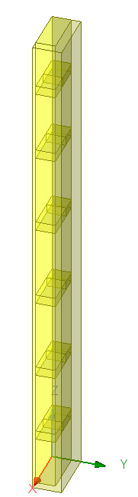
Design Project 3
By : Nittala Satya Surya Lakshmi Vasuki Siva Srinivas
#Id – 620094
Email – sn620094@wne.edu

Slide 2
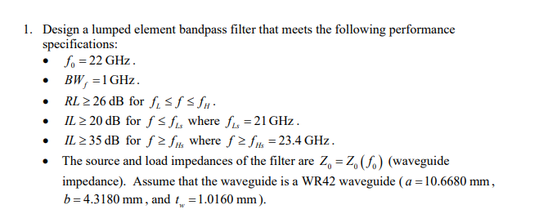

Slide 3
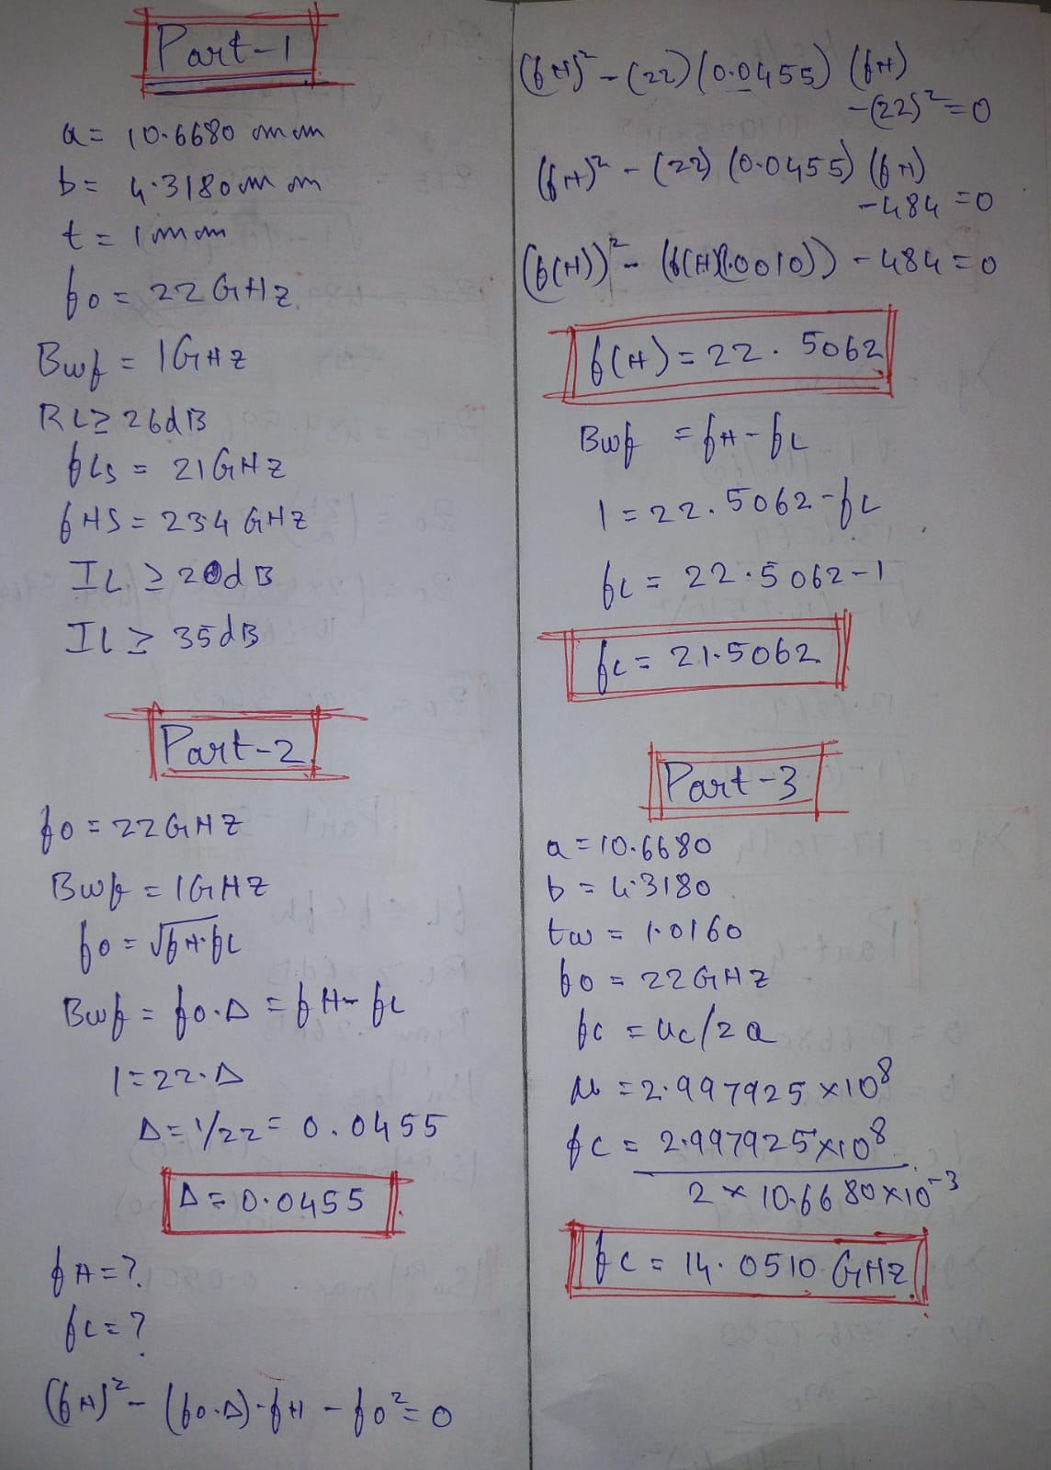
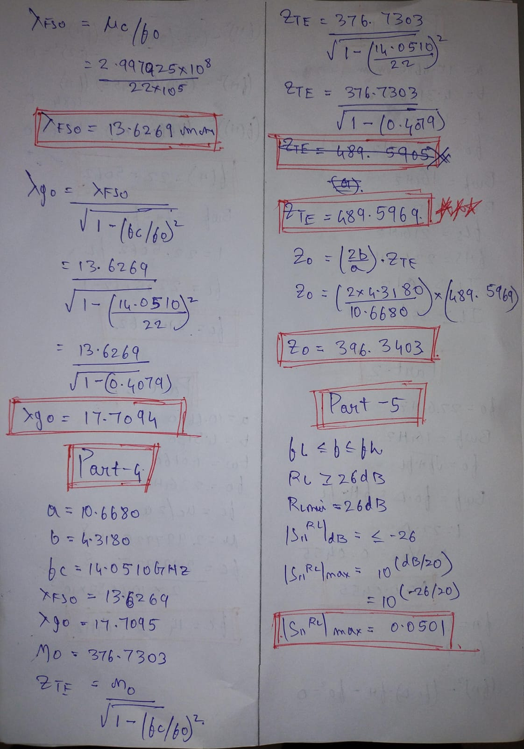
Hand Calculations

Slide 4
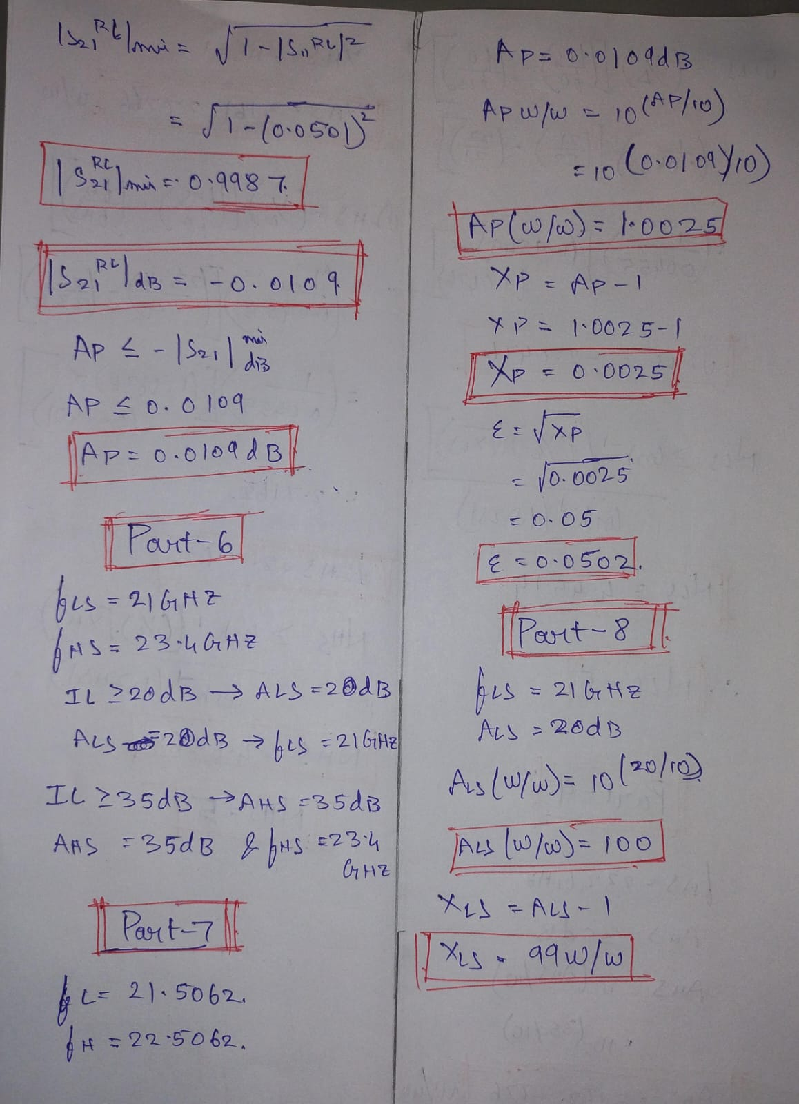
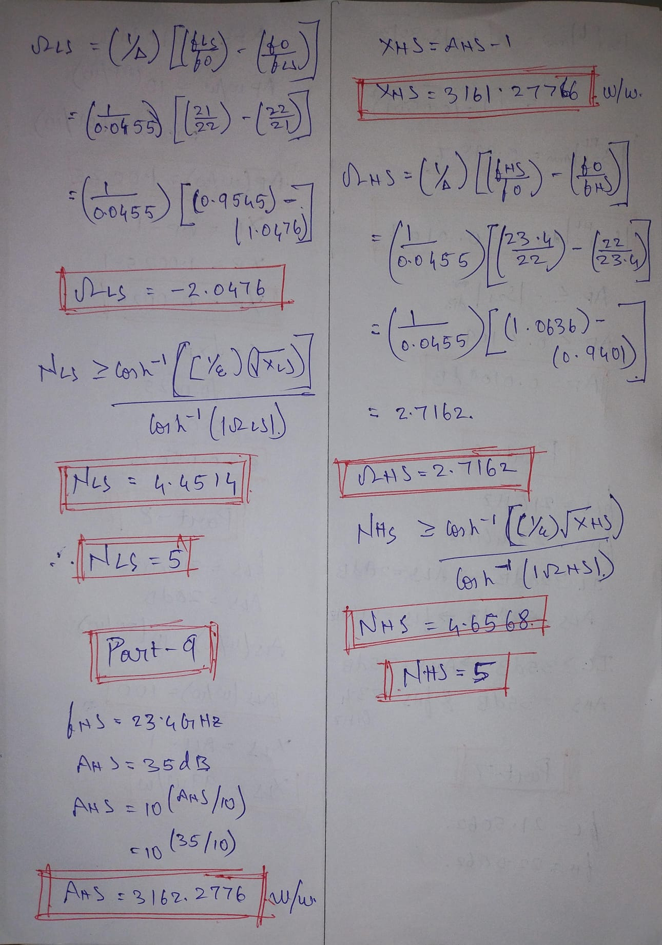
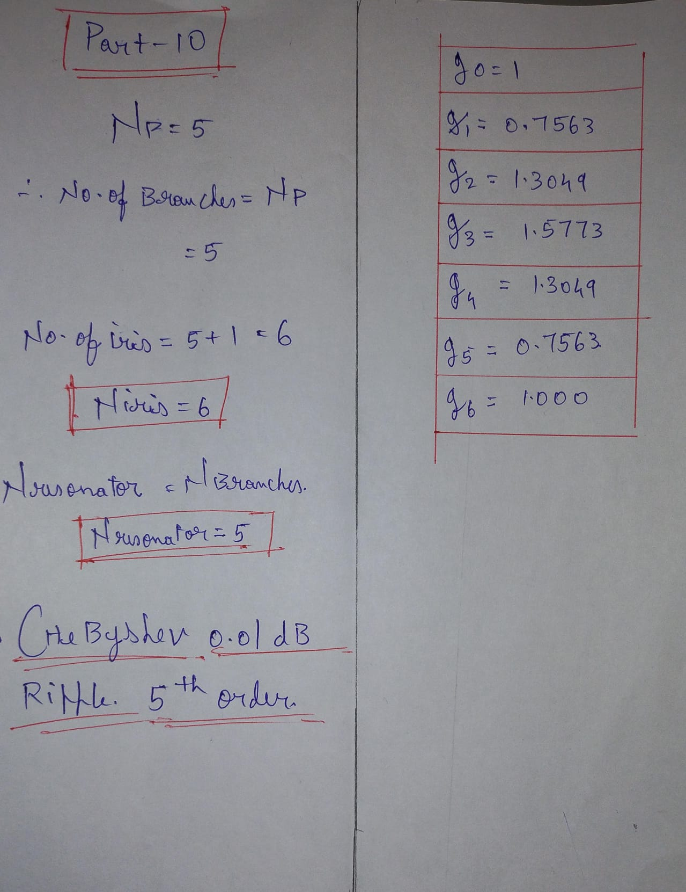

Slide 5
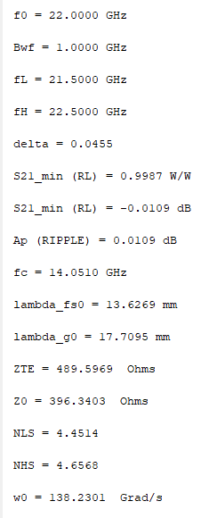
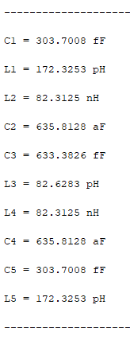
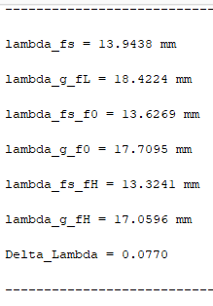
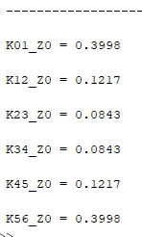
MATLAB Calculations

Slide 6
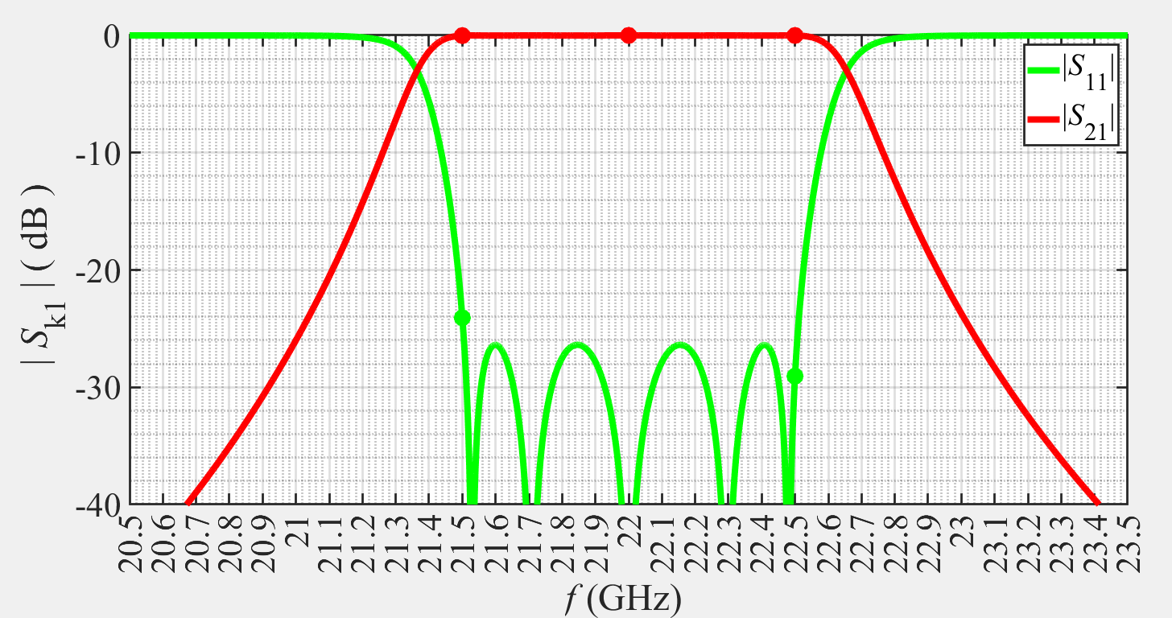
MATLAB Ideal Lumped Elements

Slide 7
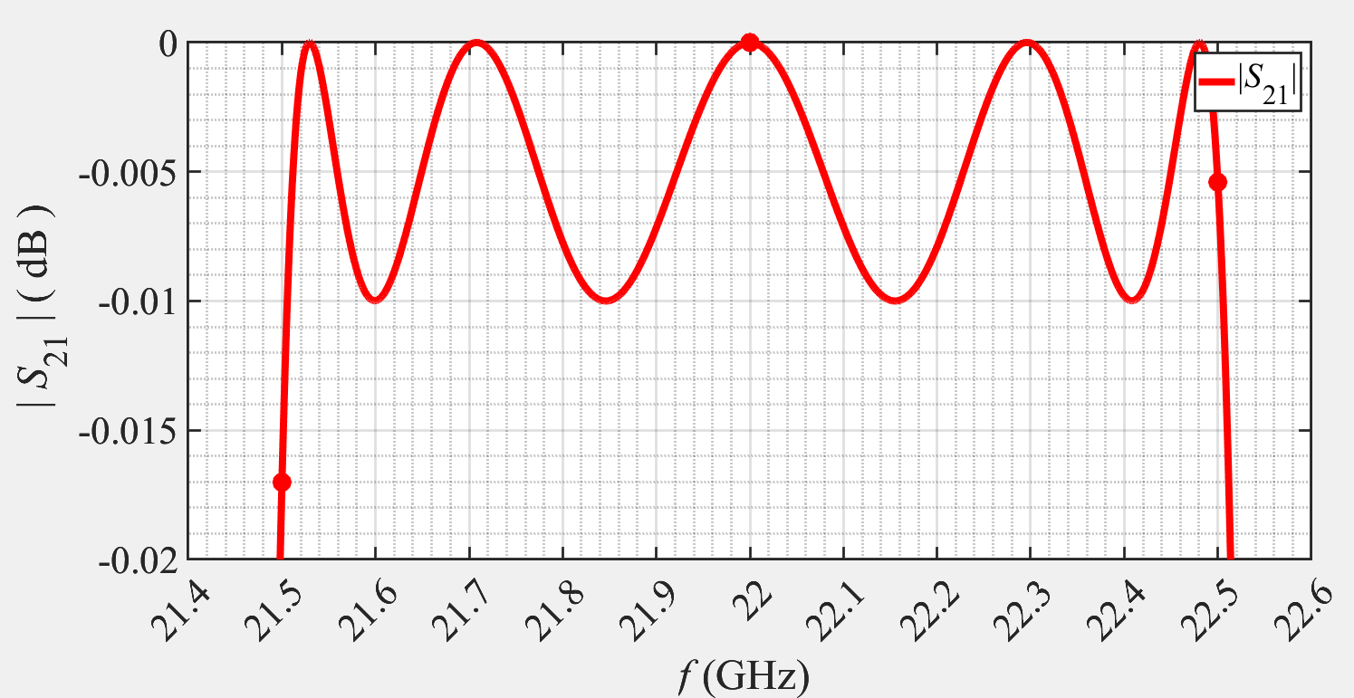

Slide 8
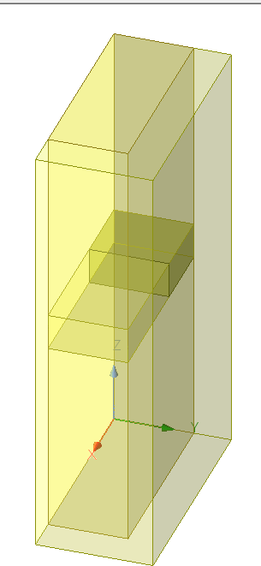
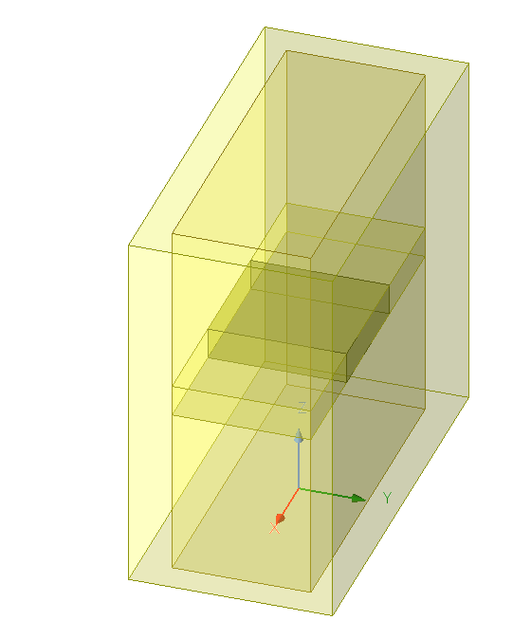
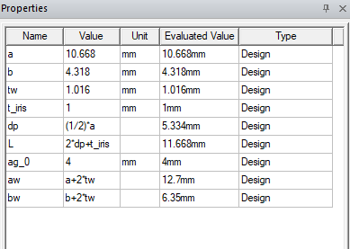
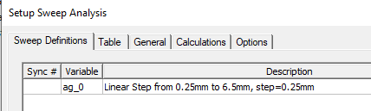
Waveguide inductive iris BPF Design
BPF Full Model Iris Sweep
BPF Quarter Model Iris Sweep

Slide 9
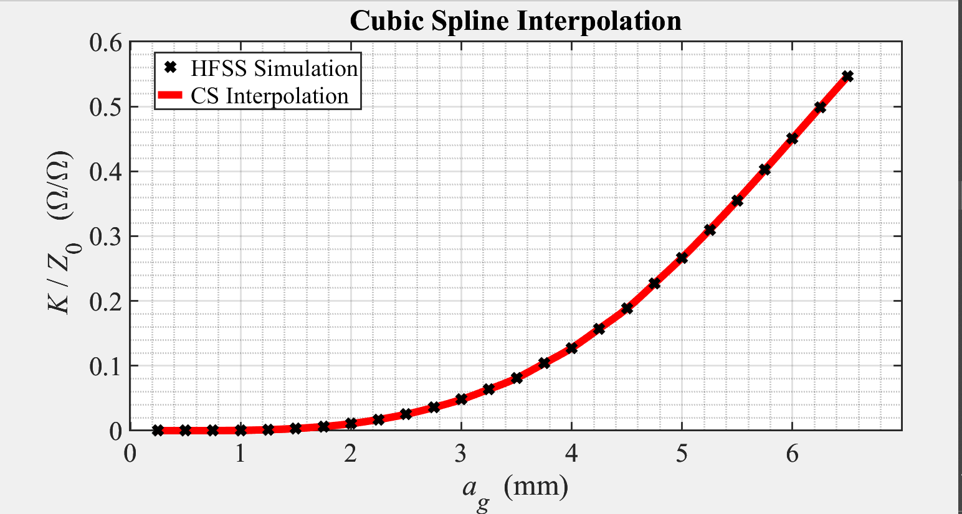
Iris Sweep - Cubic spline Interpolation

Slide 10
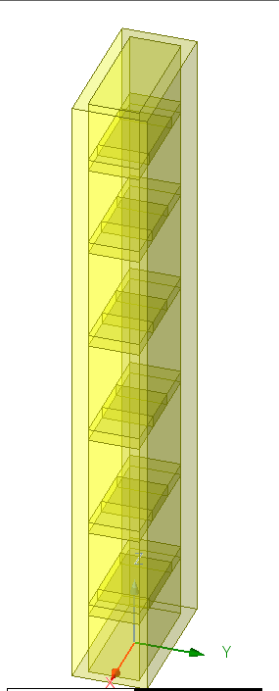
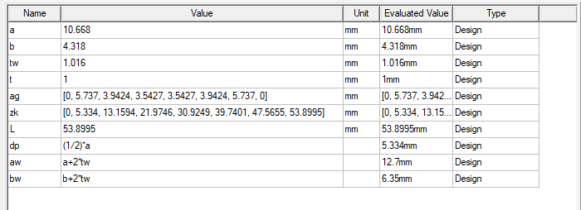
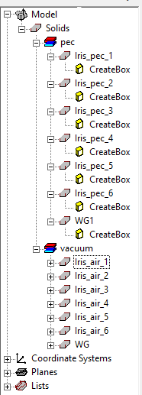
WG iris BPF HFSS (PEC)
BPF iris Full Model Pec

Slide 11
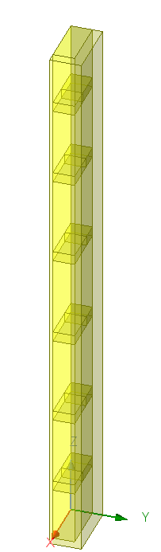
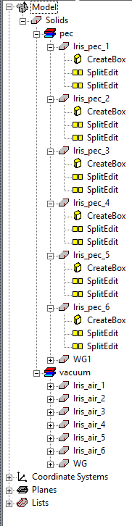
BPF iris Quarter Model Pec

Slide 12
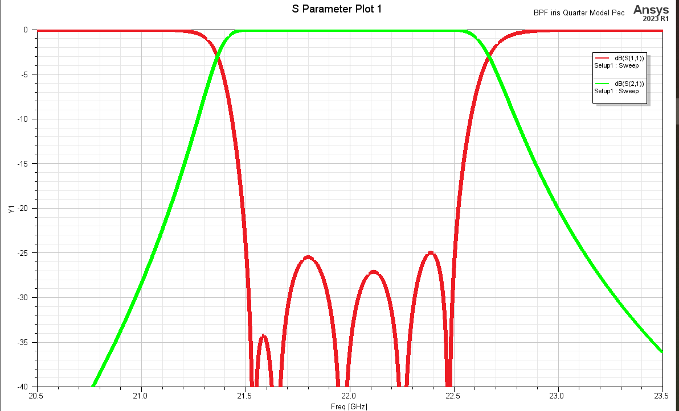

WG iris BPF HFSS (PEC) $\left|S_{11}\right|$ and $\left|S_{21}\right|$

Slide 13
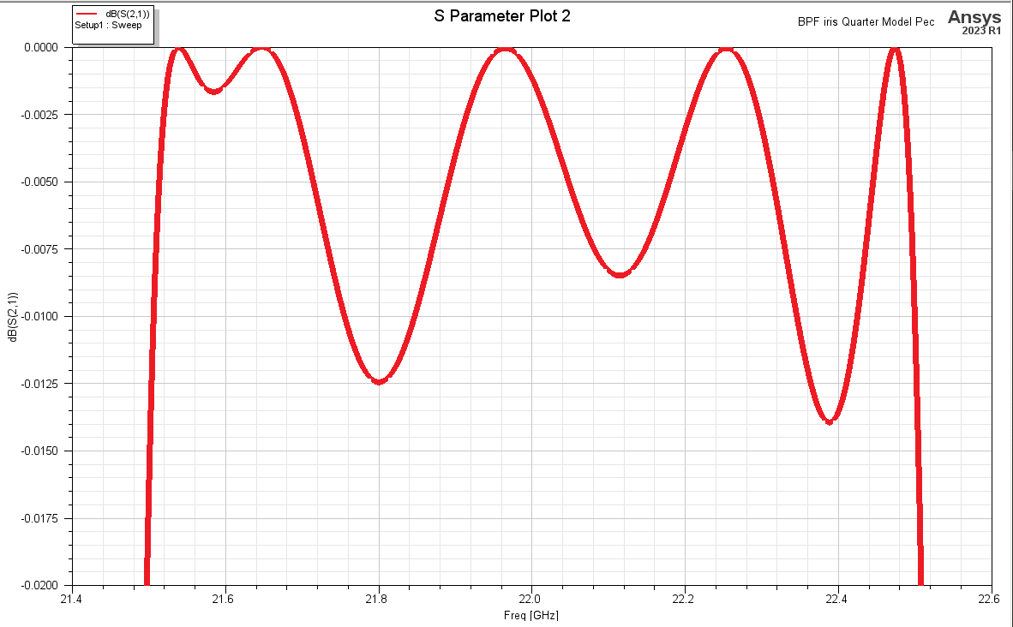

WG iris BPF HFSS (PEC) $\left|S_{21}\right|$

Slide 14
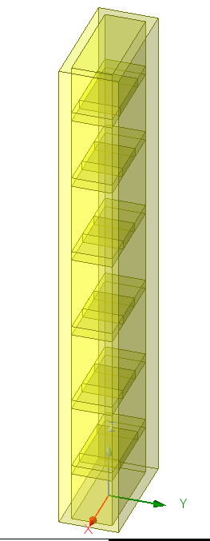
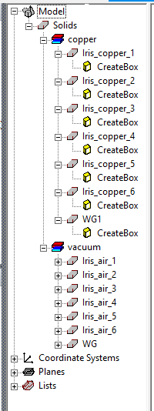
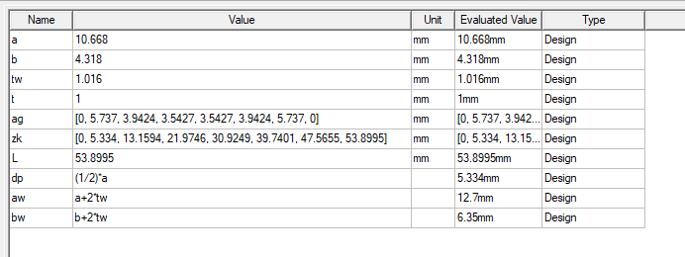
WG iris BPF HFSS (Copper(Loss))
BPF iris Full Model Copper

Slide 15
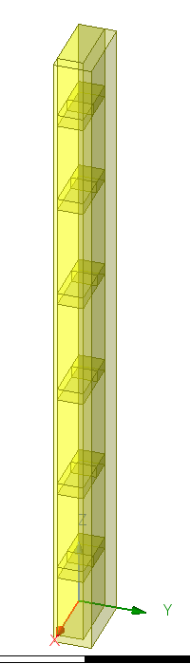
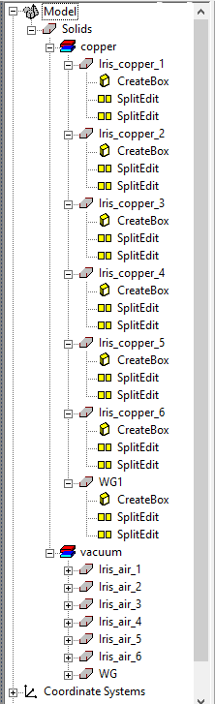
BPF iris Quarter Model Copper

Slide 16
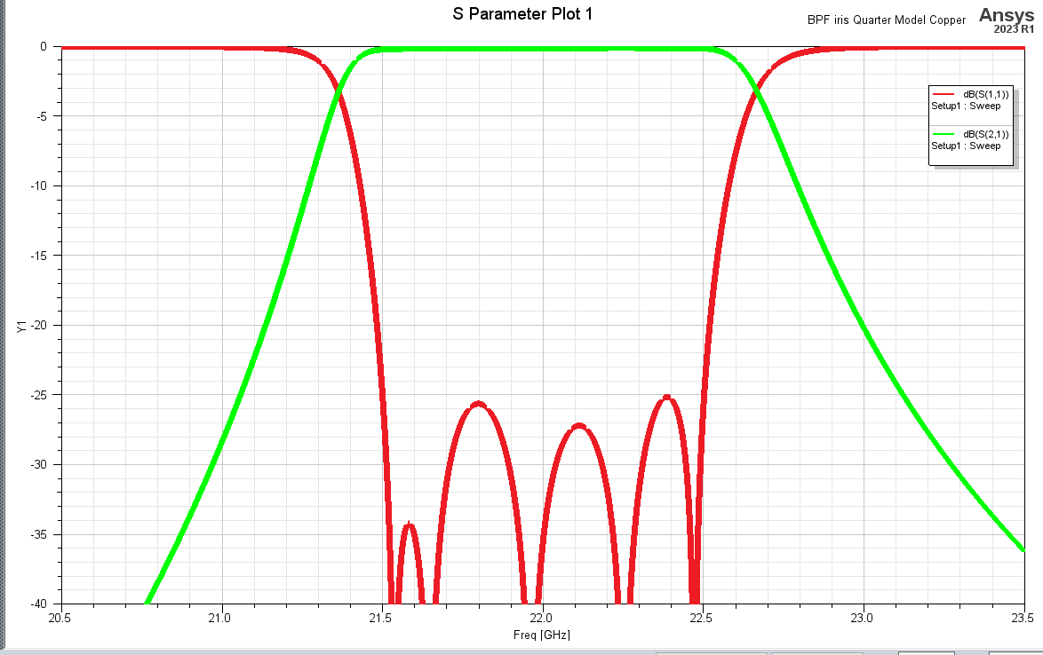
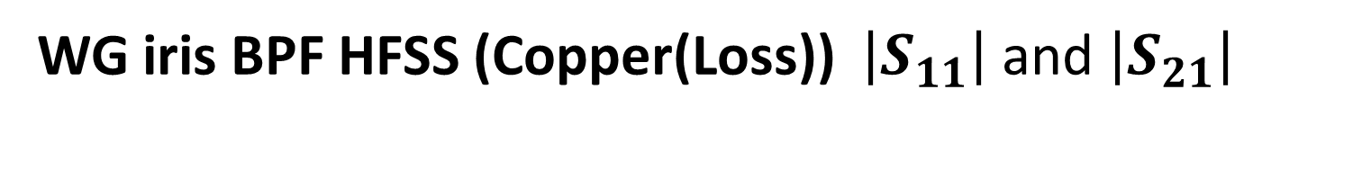
WG iris BPF HFSS (Copper(Loss)) $\left|S_{11}\right|$ and $\left|S_{21}\right|$

Slide 17
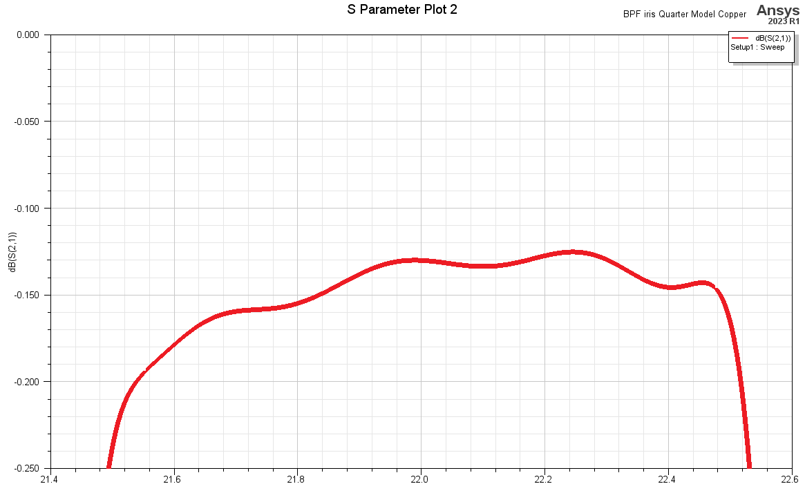
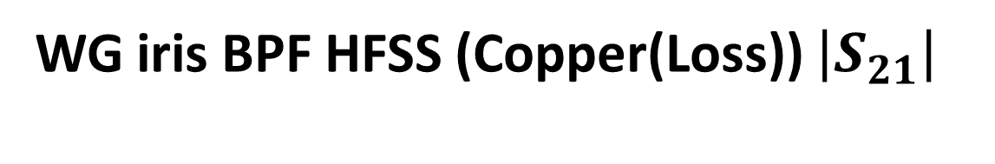
WG iris BPF HFSS (Copper(Loss)) $\left|S_{21}\right|$

Slide 18
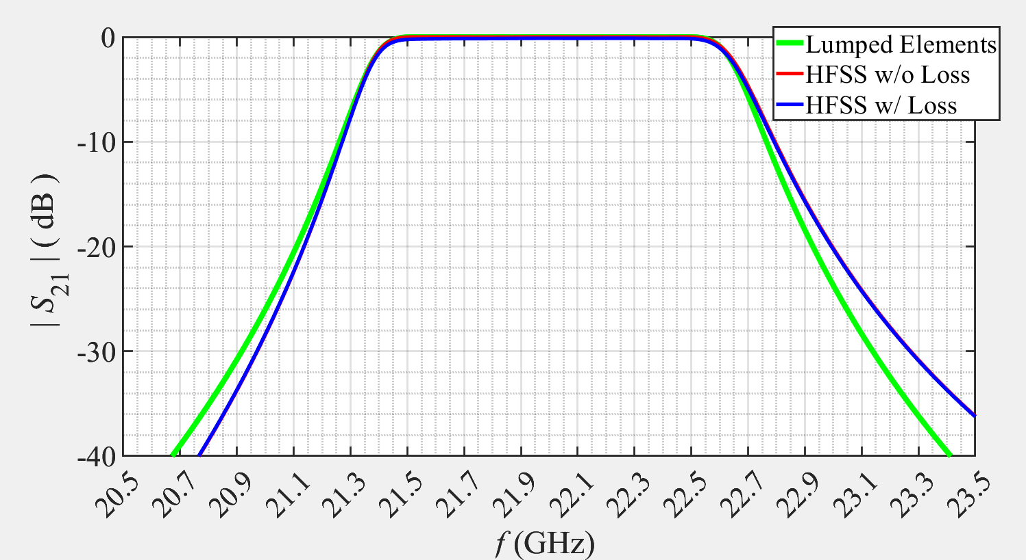
Summary of the outcomes.

Slide 19

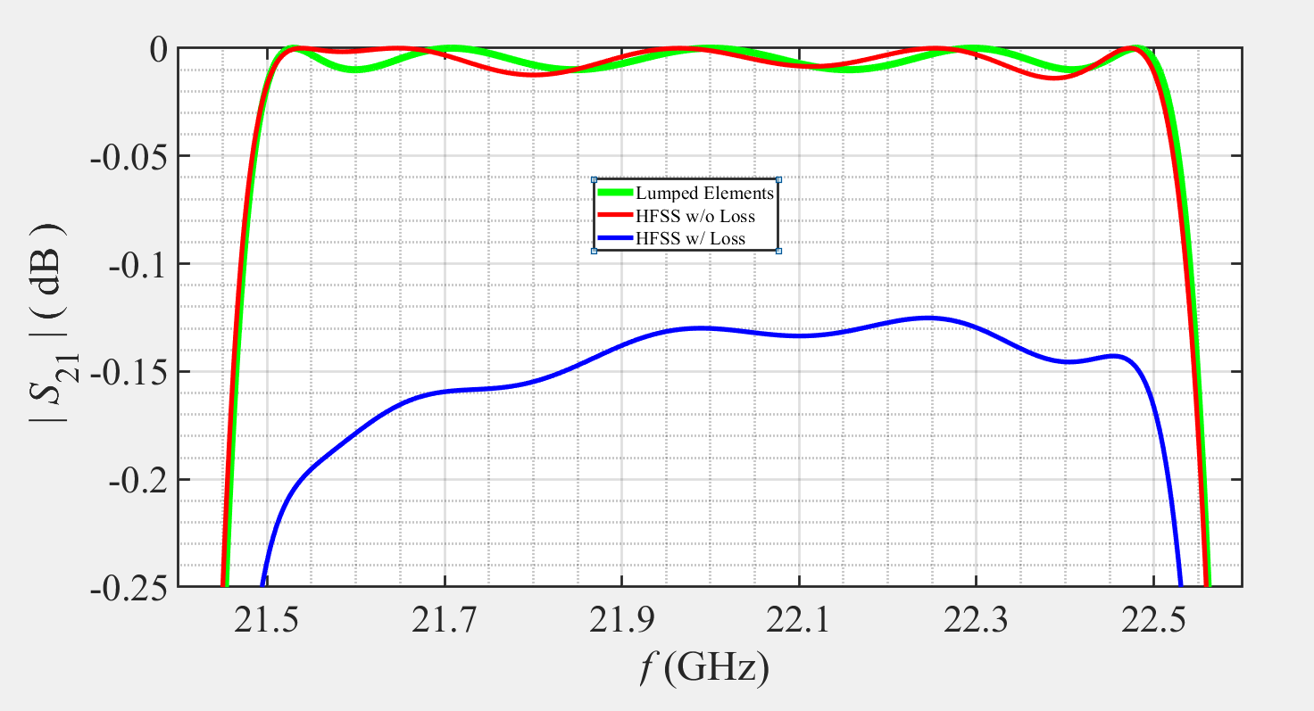

Slide 20

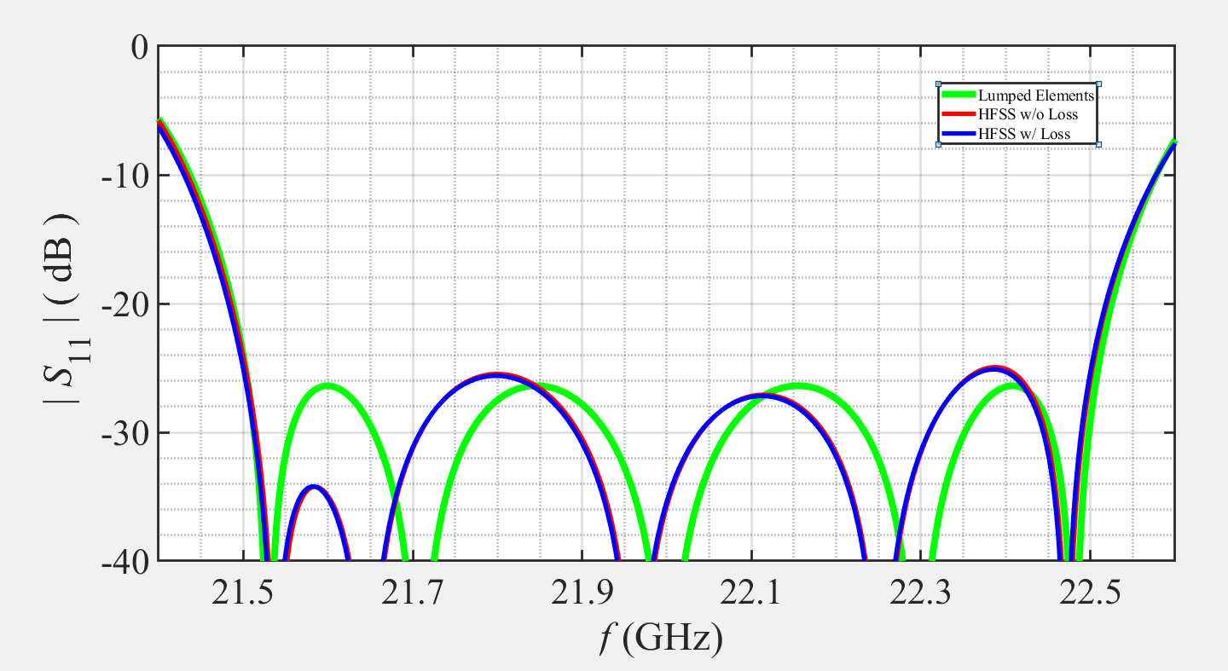

Slide 21
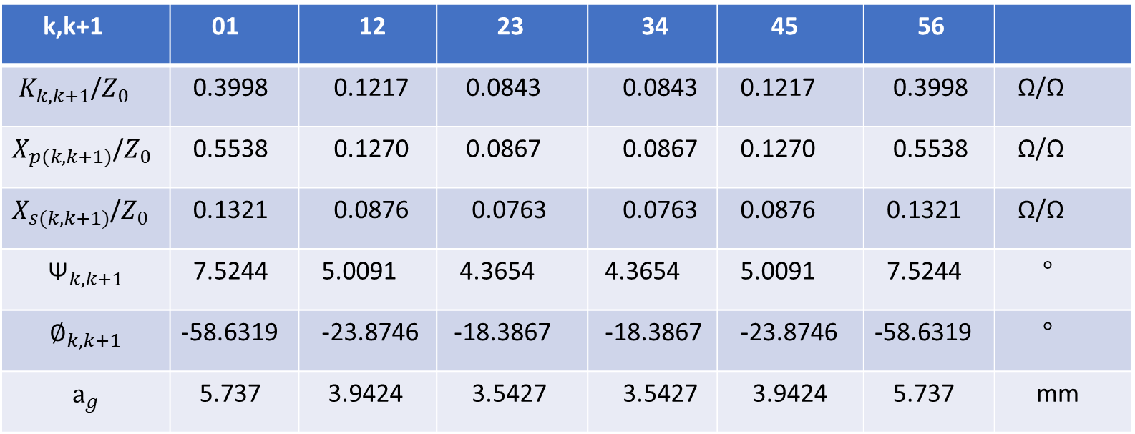
Table 01
k,k+1 | 01 | 12 | 23 | 34 | 45 | 56
$K_{k,k+1}$/$Z_{0}$ | 0.3998 | 0.1217 | 0.0843 | 0.0843 | 0.1217 | 0.3998 | Ω/Ω
$X_{p(k,k+1)}$/$Z_{0}$ | 0.5538 | 0.1270 | 0.0867 | 0.0867 | 0.1270 | 0.5538 | Ω/Ω
$X_{s(k,k+1)}$/$Z_{0}$ | 0.1321 | 0.0876 | 0.0763 | 0.0763 | 0.0876 | 0.1321 | Ω/Ω
$${\text{Ψ}}_{k,k+1}$$ | 7.5244 | 5.0091 | 4.3654 | 4.3654 | 5.0091 | 7.5244 | $°$
$${\text{∅}}_{k,k+1}$$ | -58.6319 | -23.8746 | -18.3867 | -18.3867 | -23.8746 | -58.6319 | $°$
$${\text{a}}_{g}$$ | 5.737 | 3.9424 | 3.5427 | 3.5427 | 3.9424 | 5.737 | mm

Slide 22
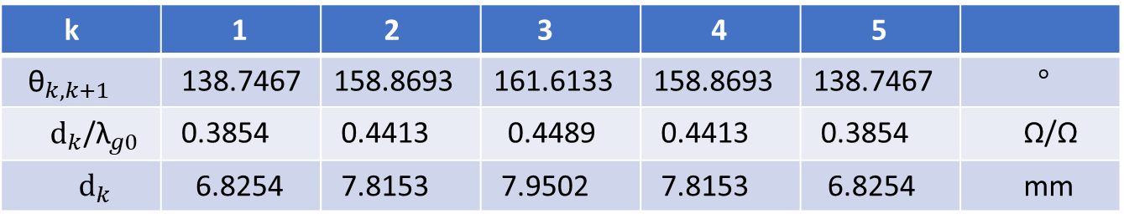
Table 02
k | 1 | 2 | 3 | 4 | 5
${\text{θ}}_{k,k+1}$ | 138.7467 | 158.8693 | 161.6133 | 158.8693 | 138.7467 | $°$
${\text{d}}_{k}$/${\text{λ}}_{g0}$ | 0.3854 | 0.4413 | 0.4489 | 0.4413 | 0.3854 | Ω/Ω
${\text{d}}_{k}$ | 6.8254 | 7.8153 | 7.9502 | 7.8153 | 6.8254 | mm

Slide 23
Appendices
HFSS
MATLAB
MS Excel

Slide 24
THE END

